Slide 1

See Something,
Say Something
Grades 6-12
1
Notes:
Hello and Thank you for taking the time to review this important informational video about See Something, Say Something

Slide 2


Brought to you by …
Safety, Security & Emergency Preparedness
BJA STOP School Violence Grant
Notes:
The See Something, Say Something campaign is brought to you by the Safety, Security and Emergency Preparedness Department of BCPS and the BJA Stop School Violence Grant.

Slide 3
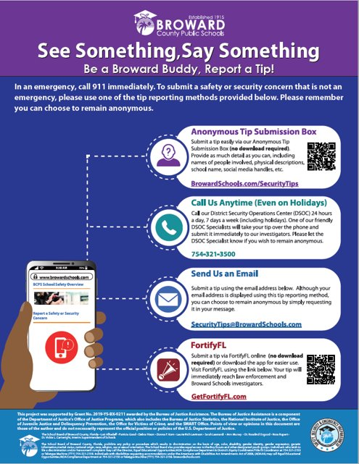
Have you seen me?
safety, security & emergency preparedness
3
Notes:
This is the See Something, Say Something campaign poster. These posters identify how to use the tip reporting tools.

Slide 4
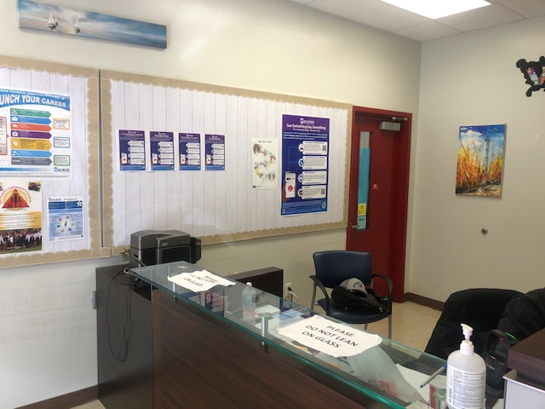
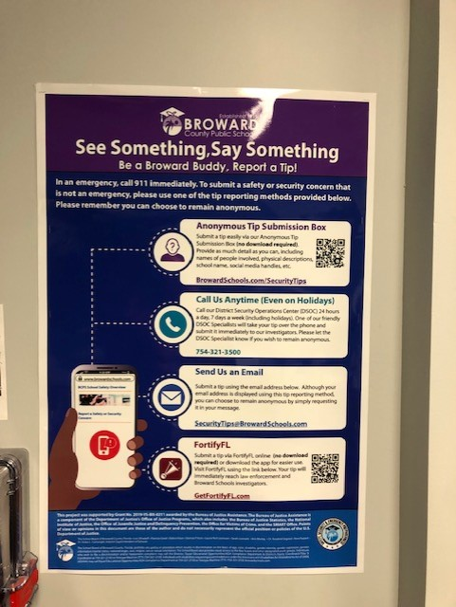
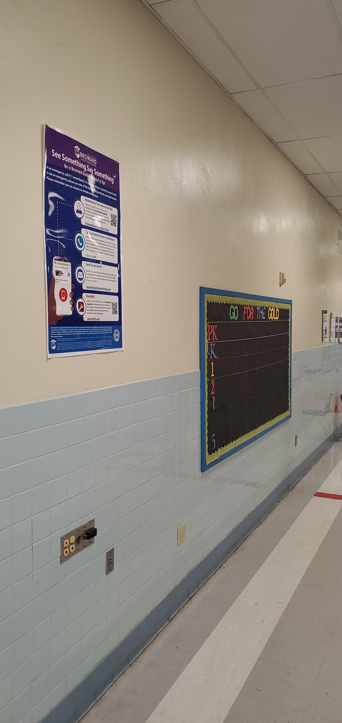
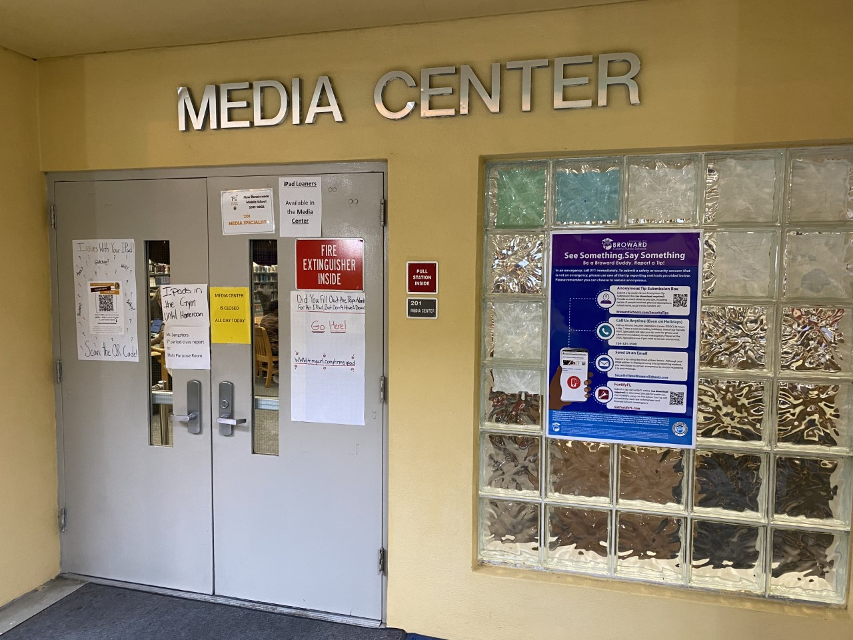
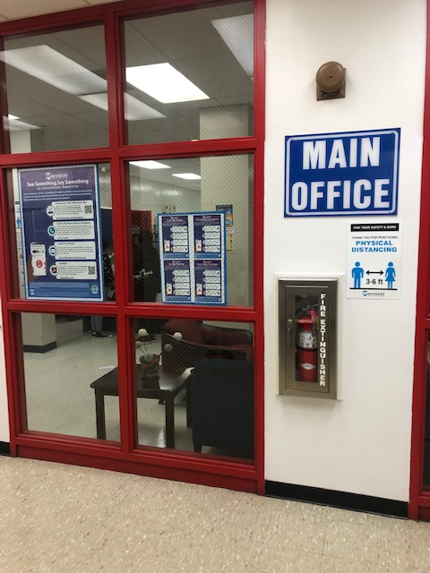
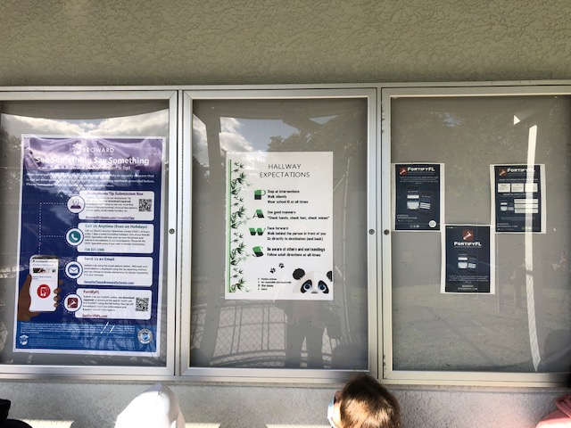
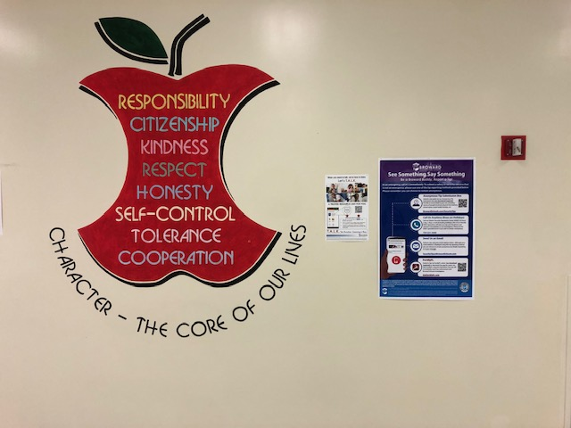
Notes:
You may see these posters in the front office, hallways, cafeteria or anywhere around your school.

Slide 5
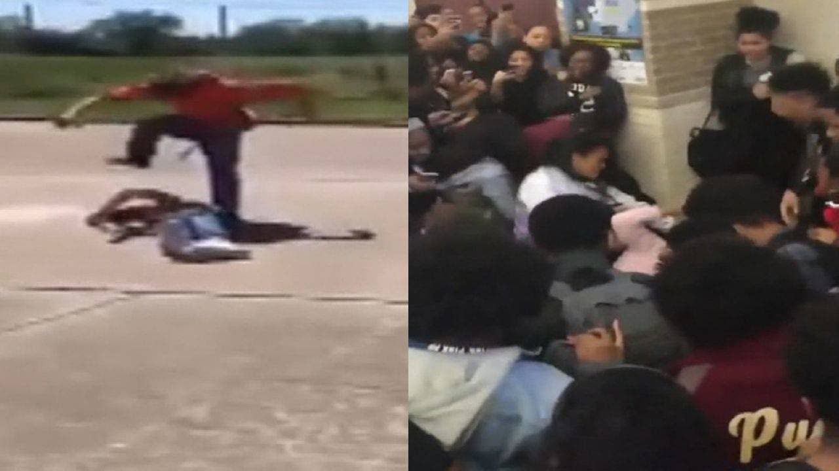
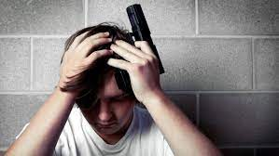
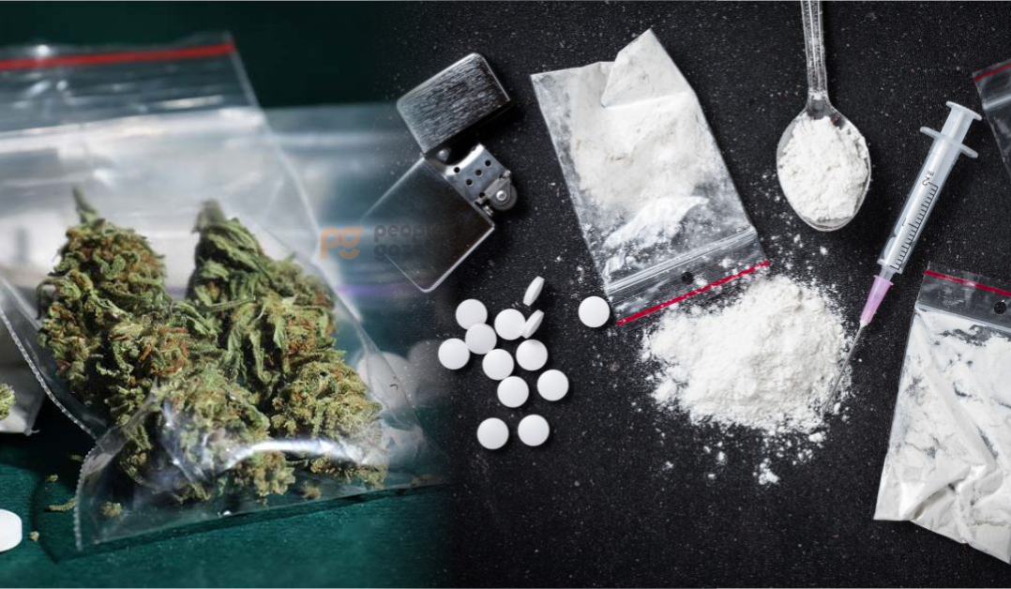

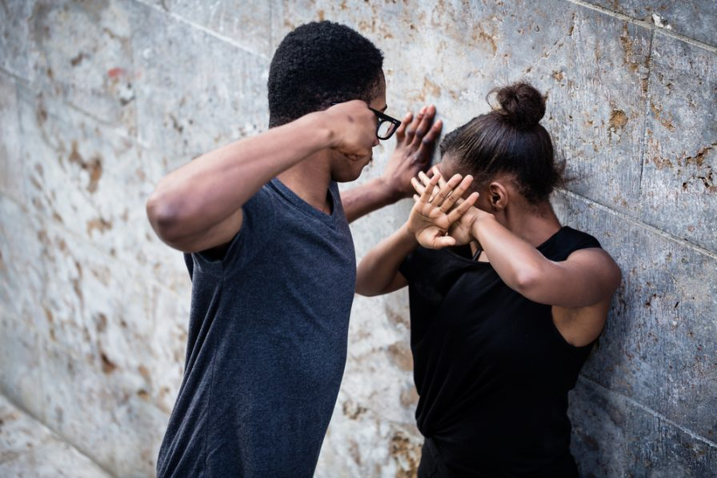
See Something ...
Fighting
Weapons
Dangerous Drugs
A Threat to Hurt Themselves or Others
safety, security & emergency preparedness
5
Notes:
If you See Something, like people fighting, someone with a weapon or dangerous drugs, or if you hear something like someone threatening to hurt themselves or someone else. (move to next slide)

Slide 6



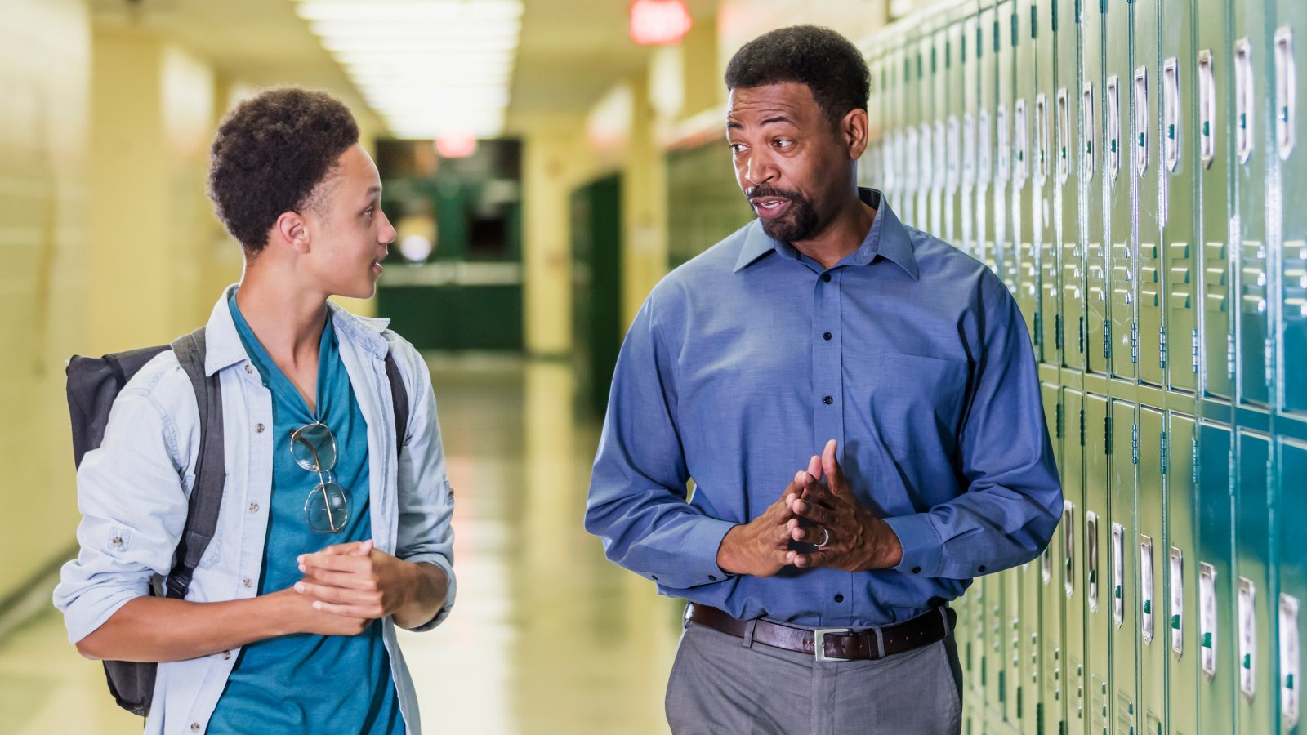
Say Something ...
Talk to an adult you trust
Encourage your friends to tell someone
Don't keep dangerous secrets
Talk to your teacher
safety, security & emergency preparedness
6
Notes:
Please say something, talk to an adult that you trust, talk to your teacher, don't keep dangerous information to yourself, and encourage your friends to tell someone. When you’re helping to keep people safe, it’s NOT snitching!

Slide 7






5 Official Tip Reporting Tools
    Quick/Anonymous Tip Submission via www.Browardschools.com/SecurityTips
    Call the District Security Operations Center (DSOC) at 754-321-3500
    Email to SecurityTips@Browardschools.com
    FortifyFL at www.GetFortifyFL.com – On your Clever page
    SaferWatch -DOWNLOAD REQUIRED
Notes:
There are 5 official tip reporting tools:
The Quick Tip Submission Box
A call to DSOC our District Security Operations Center
Sending an email
Our anonymous tip submission through Fortify Florida which is located on your Clever page
SaferWatch

Slide 8
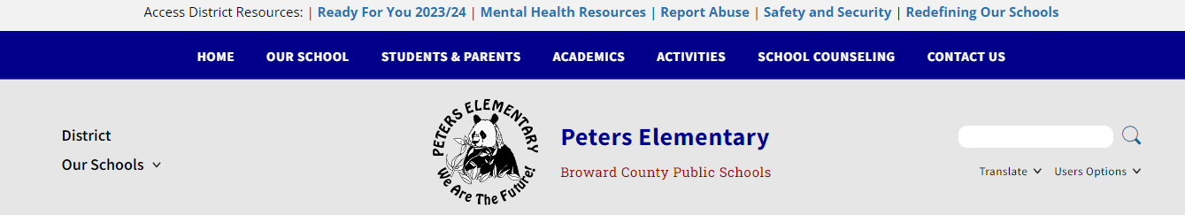
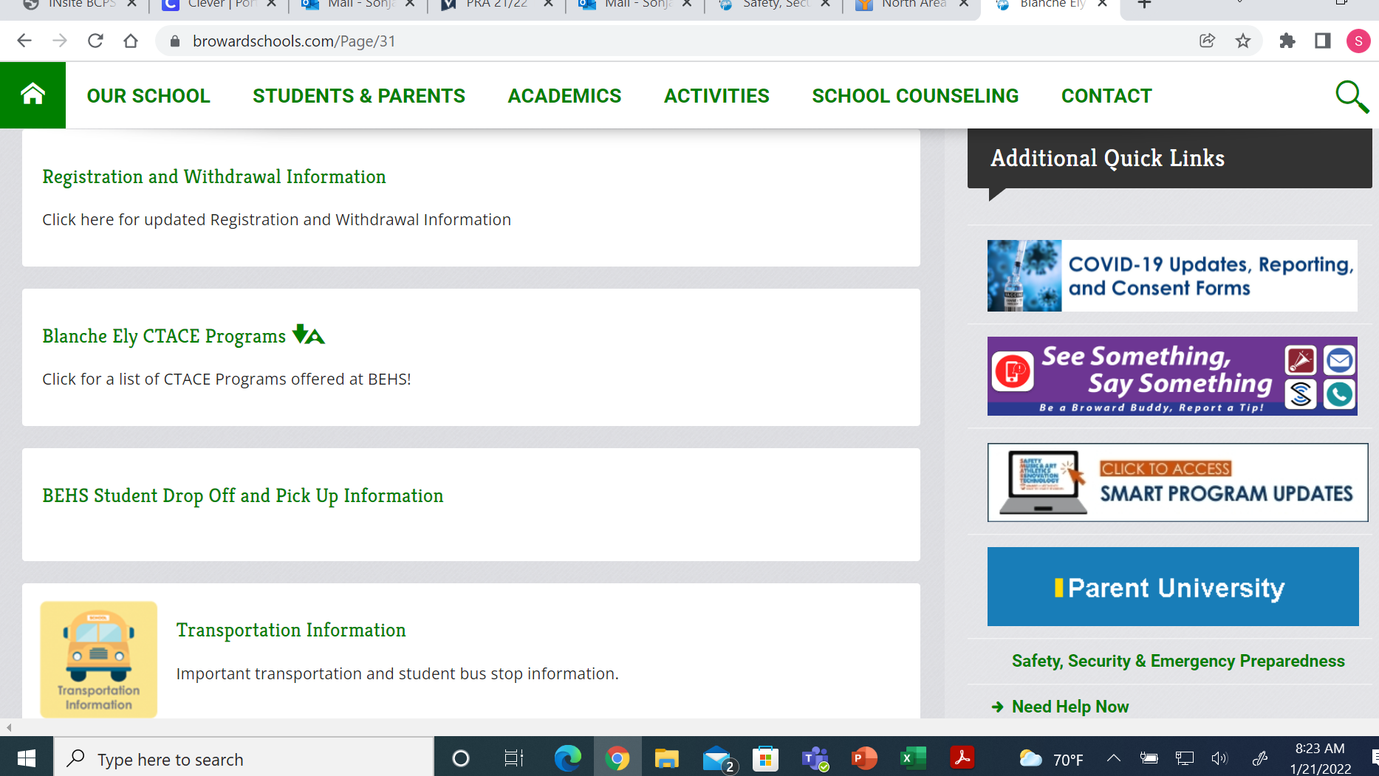
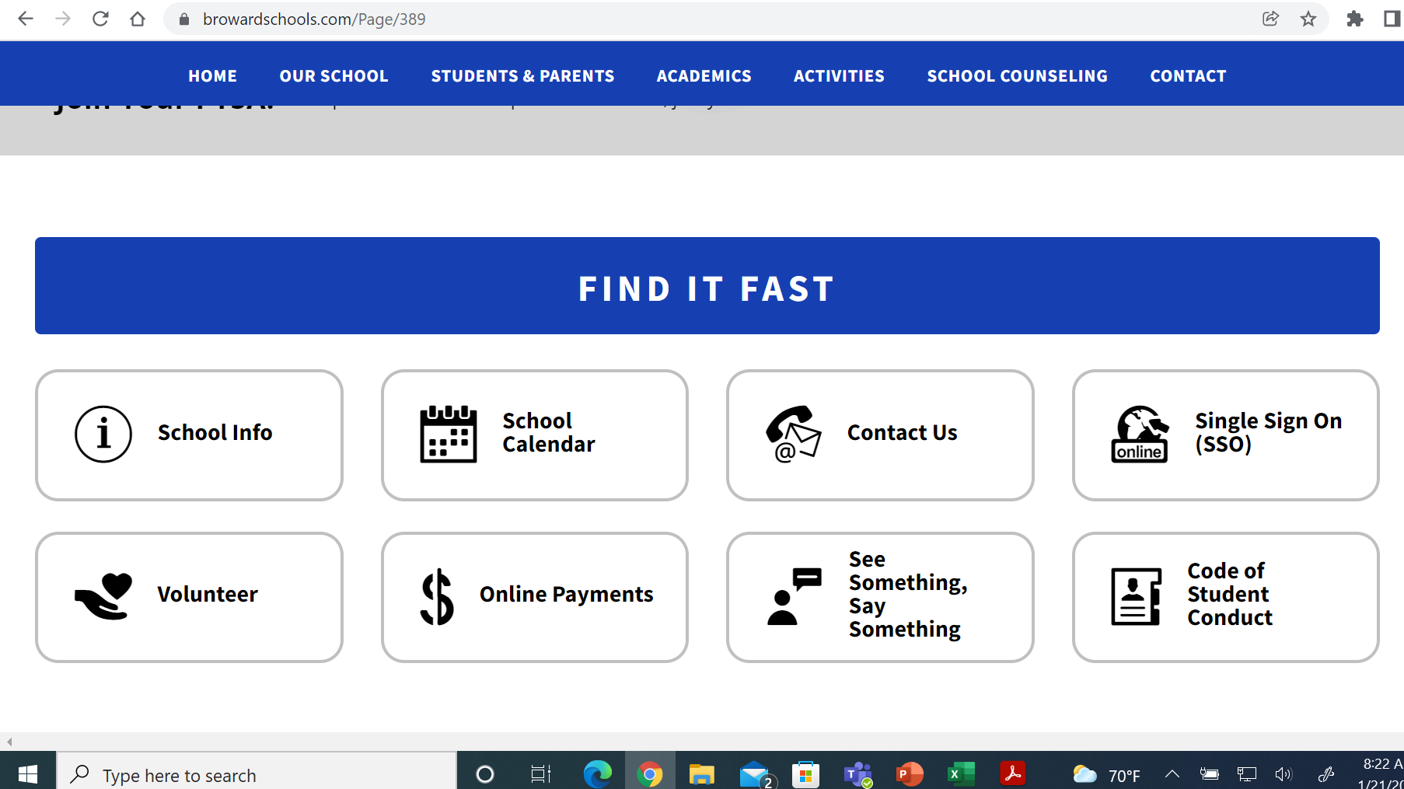
Where can I find See Something, Say Something?
Notes:
In order to get to the safety and security tip reporting page you can click the “Safety and Security” tab on the top of your schools website, or under “Find It Fast” the ”See Something, Say Something” tab also under “Additional Quick Links” the ”See Something, Say Something” tab will also take to the safety and security tip reporting page.

Slide 9
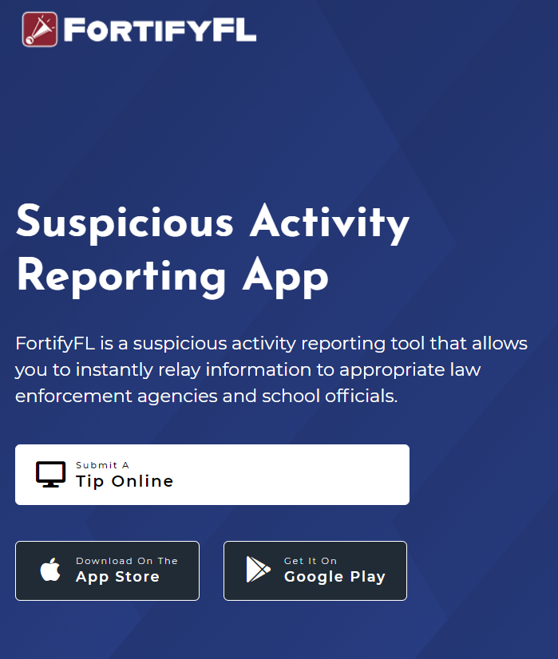
FortifyFL
How to submit a tip:
Go to GetFortifyFL.com and Click “Submit a Tip Online”
Notes:
About Fortify Florida, you can submit a tip by going to your Clever page or GetFortifyFL.com and click “Submit a tip online”

Slide 10
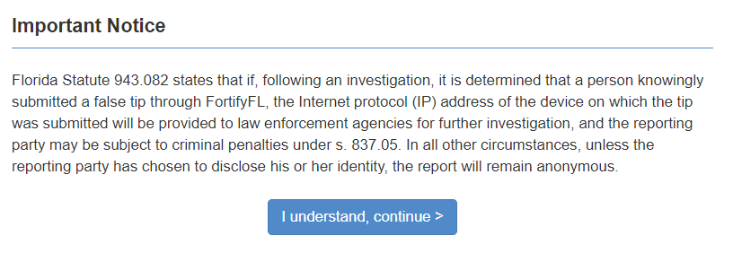
FortifyFL
FortifyFL is for Serious Tips Only
If anyone uses FortifyFL to send a fake tip, the police will investigate. Fake tips could lead to serious consequences.
Notes:
FortifyFL is not for jokes. Tips that are sent through FortifyFL are taken very seriously. Joking around or sending fake stories can mean serious trouble.

Slide 11
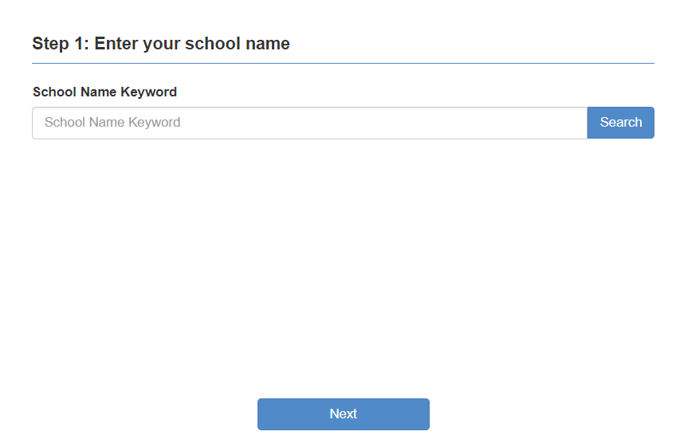
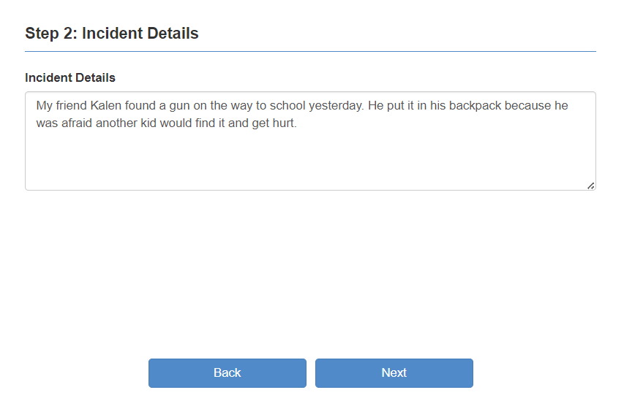

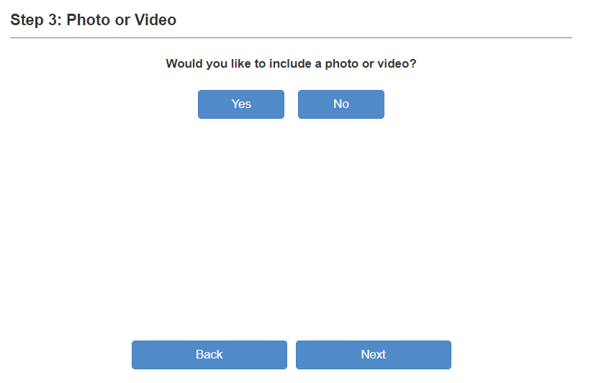
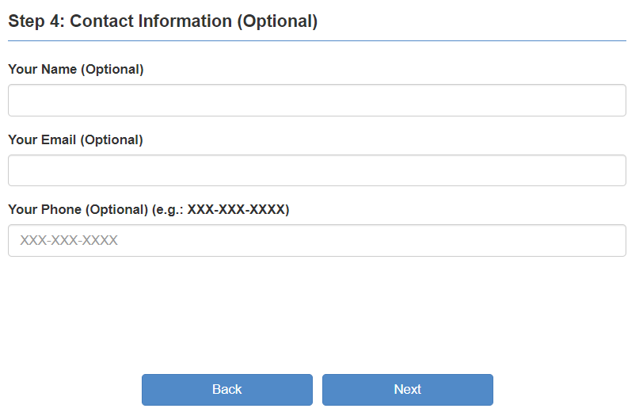
FortifyFL
Include WHO did WHAT, WHERE it happened and WHEN.
Tips must have useful information
Step 1: Select your school
Step 2: Provide your Tip
Step 3: Attach a video or photo
Step 4: Optional - Provide contact
information and Submit
Notes:
To submit a tip there are 4 easy steps:
Select your school.
Provide your tip, include as much information as you can, include the who did what, where it happened and when. More information will get help faster.
Attach any videos or photos you have.
Provide contact information and submit – your contact information is not mandatory and if included it is not made public.

Slide 12
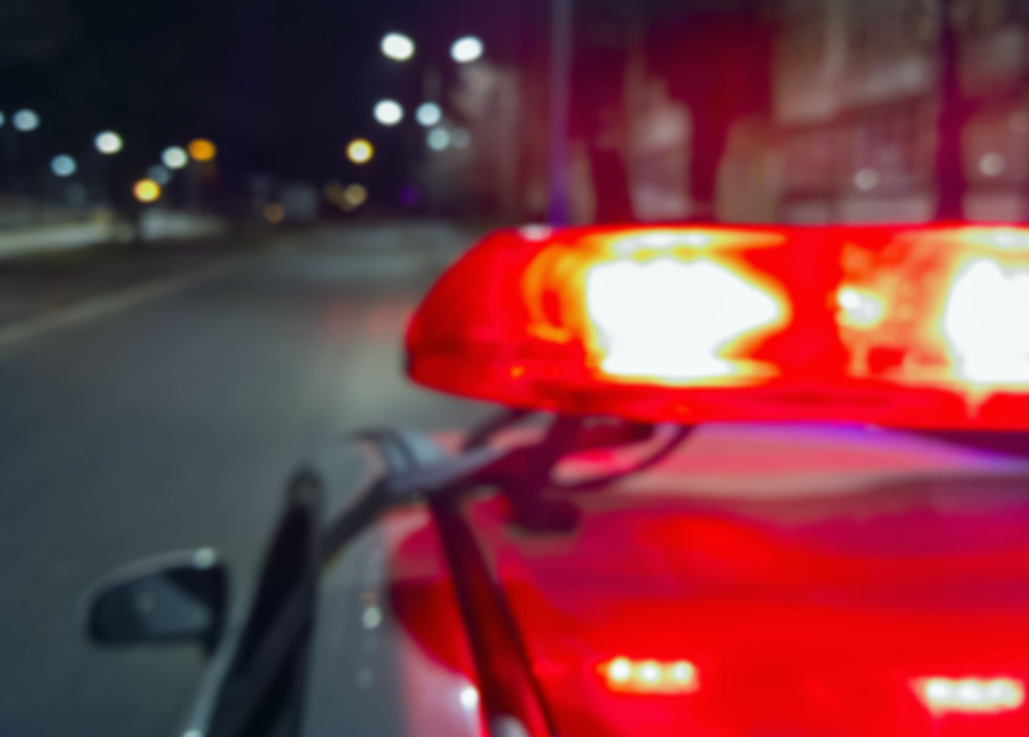
FortifyFL
Remember: FortifyFL is only for reporting dangerous situations or suspicious behavior
There are serious consequences for reporting fake tips
Notes:
Remember, Fortify Florida is ONLY for reporting dangerous situations or suspicious behavior. There are serious consequences for reporting fake tips.

Slide 13
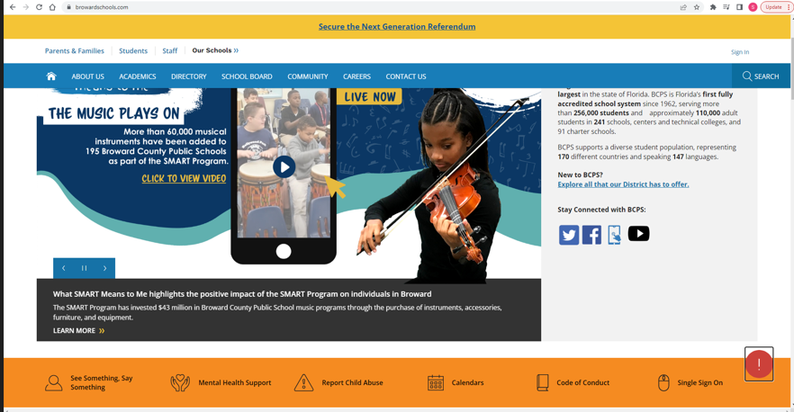
Located on All BCPS District Websites
safety, security & emergency preparedness
13
Notes:
Additionally, All BCPS District websites have been updated to include a “See Something, Say Something” icon in the orange banner.

Slide 14

Remember, If you ...
safety, security & emergency preparedness
14
Notes:
If you See Something, Say Something, please do your part and help us try to keep your school a safe environment.

Slide 15
School Board of Broward County
Laurie Alhadeff, Chair​
Debra Hixon, Vice Chair​
​
Dr. Allen Zeman​
Daniel Foganholi
Torey Alston Dr. ​
Sarah Leonardi​
Dr. Jeff Holness​
Brenda Fam, Esq. ​
Nora Rupert​
​
Dr. Howard Hepburn
Superintendent of Schools
The School Board of Broward County, Florida, prohibits any policy or procedure which results in discrimination on the basis of age, color, disability, gender identity, gender expression, genetic information, marital status, national origin, race, religion, sex or sexual orientation. The School Board also provides equal access to the Boy Scouts and other designated youth groups. Individuals who wish to file a discrimination and/or harassment complaint may call the Director, Equal Educational Opportunities/ADA Compliance Department & District’s Equity Coordinator/Title IX Coordinator at 754-321-2150 or Teletype Machine (TTY) 754-321-2158.
Individuals with disabilities requesting accommodations under the Americans with Disabilities Act Amendments Act of 2008, (ADAAA) may call Equal Educational Opportunities/ADA Compliance Department at 754-321-2150 or Teletype Machine (TTY) 754-321-2158.
www.browardschools.com

